Slide 1


Wharton PLASTARC People Analytics Case Competition
Understanding Employee Workplace Preferences
Team - SFRR Analytics

Slide 2





SFRR Analytics Team Introduction
BUSINESS ANALYTICS AND DATA SCIENCE, MS
Frankle Muchahary
Roe Djer Tan
Ritwik Roy Chowdhury
Shreyan Datta Chakraborty

Slide 3




Problem Statement: Shifting of Working Patterns
+500%
50%
1,384
?
WFH increased from 5% to 30% since 2019
Office occupancy at half of
pre-pandemic level
Gathered 1,384 surveys with 183 questions from 5 organizations
Productivity?
Preference?
How can an organization best support its employee?

Slide 4



Executive Summary
Complication
Employees have a wide range of preferences and very specific needs
Negative perception can drive down employee satisfaction
Need to understand employees and fine tune to support their work styles
Varying Problems
Large no. of productive hours lost due to office layout and collaboration issues
Ability to collaborate effectively - key factor for determining work location
WFH Employees tend to be bit averse to cultural engagement – need to understand preferences & tailor engagement activities
Recommendations
Introduce a Gen AI Workforce Copilot - empower employees with an assistant
Workplace design modifications to boost collaboration & focus
Fine-tune events to employee interests. Recognizing merit is key
Estimated 418 hours increase in productive hours per week.
Estimated Satisfaction Index improvement by almost 1.6 points

Slide 5
Analysis on Productivity & Workplace Preference

Slide 6



Ability to Collaborate Effectively is a key factor in determining Perceived Productivity
Colleague Access
Manager Interaction
Team
Meetings
Social Events
Client Engagement
[1] Average of Perceived Ability to Focus, Create, and Innovate; 0 = Home Preferred, 5 = Office Preferred
[2] Average of Perceived Ability for Colleague Access, Team Meetings Participation, Client Engagement, Social Events, and Manager Interaction; 0 = Home Preferred, 5 = Office Preferred

Slide 7
Employees that prefer to work from home lost ~70 mins more on average due to office distractions pre-covid
+70 min
Lost less time at the office due to distractions pre-covid
Lost more time at the office due to distractions pre-covid
Layout Issues
Noise Disturbances
280
274
Time Loss Due to Distractions
(Minute/Week)
256
Visitor Disturbance
210
189
WFH Preference Rate
0-20%
20-40%
40-60%
60-80%
80-100%
Productivity Quotient ^{[1]} | 3.6 | 3.2 | 1.9 | 1.8 | 0.6
Feels more productive at home
[1] Average of Perceived Ability to Focus, Create, and Innovate; 0 = Home Preferred, 5 = Office Preferred

Slide 8
Employees that prefer working from home do not feel office involvement is important
Socially engaged employees prefer office work
3.1
3.1
3.0
3.0
Cultural Quotient ^{[1]}
2.9
2.9
2.9
2.8
WFH employees do not value office involvement/initiatives as much
2.7
2.6
2.5
2.5
0.0
0-20%
20-40%
40-60%
60-80%
80-100%
WFH Preference Rate
[1] Average Importance of Factors (Sense of Purpose, Belonging, and Community; Social Events; Community Initiatives; Leaderships Expectation/Policy Guidance) Influencing Decision to WFH or at Office; 0 = Unimportant, 5 = Important
Notes:
Forbes acknowledges the challenge of enforcing office culture in a WFH (Work From Home) setting

Slide 9


Ability to spend uninterrupted focused hours drives work location preferences
Preferred Environment for Focused Work
0.8
Employees who like to switch from focused work to collaborative work/social events intermittently prefer open workspaces
WFH Preference Rate
0.6
0.4
0.2
0.0
Home
Temporary Workspace
Office Workstation
Enclosed Office Space

Slide 10
Satisfaction from collaborating in the office could potentially highlight employees’ workplace preference
Office goers are satisfied with the office collaboration setup
Office Collab Satisfaction ^{[1]}
Employees who have >60% WFH Preference Rate are less satisfied with Office Collab Setup
0-20%
20-40%
40-60%
60-80%
80-100%
WFH Preference Rate
[1] Average Satisfaction for Inperson and Virtual Collaboration using Office Space and Tech; 0 = Unsatisfied, 5 = Satisfied

Slide 11




“Composite Work Location Preference” score can be utilized for gauging employees’ workplace preference
Ability to
be Individually Productive
Ability to
Collaborate Effectively
-2.4
Composite Work Location
Preference Score ^{[1]}
Strongly
Influence
Location Employee Prefer to Work in
0-20%
20-40%
40-60%
60-80%
80-100%
WFH Preference Rate
[1] Average of Perceived Optimal Work Environment for Supporting All Aspects ; 0 = Home Preferred, 5 = Office Preferred.
Used as a Proxy to handle missing values in WFH Pref Rate Metric

Slide 12
Factor Analysis & Shapley Values corroborate our analysis about the key factors for determining work location preference
Data
Factor Name | Factor Alignment / Description | Shapley Values
Factor 9 – Workplace for Focus & Collab | Preferred workplace and location for in-person collaboration and tasks that require undivided attention | 0.36
Factor 3 – Preferred Workplace Features | Importance of workplace and work environment features | 0.35
Factor 1 - Collaboration Satisfaction | Employee satisfaction levels with respect to collaboration in the workplace | 0.22
Factor 10 – Productivity Hindrances | Major workplace issues that contributed to loss of productive hours | 0.20
Preprocess Data For Modeling
Decompose
with Factor
Analysis
Decision
Tree
Model
Shapley Analysis
&
Analyze Factor
Loadings
Note: "Compositive Work Location Preference” is used as Target Variable for Decision Tree Model Calculated as an Average of Perceived Optimal Work Environment for Supporting All Aspects ; 0 = Home Preferred, 5 = Office Preferred.

Slide 13
Understanding Diverse Workforce Preferences

Slide 14


Segmenting Employees can help us understand their specific needs
Productivity and Preference of Work Location
Home Anchors
39% Sales, Mktg, HR, Mgmt
33% Tech
Hybrid Force
25% Architecture & Construction
31% Tech
22% Sales, Mktg, HR, Mgmt
Office Cohort
33% Architecture & Construction
22% Environment & Transport

Slide 15




Segment 1 (Work From Home Employees)
Productivity and Preference of Work Location
Home Anchors
39% Sales, Mktg, HR, Mgmt
33% Tech
Hybrid Force
25% Architecture & Construction
31% Tech
22% Sales, Mktg, HR, Mgmt
Office Cohort
33% Architecture & Construction
22% Environment & Transport
PROBLEM
PREFERENCE
SATISFACTION
105 min/week
Important (4/5)
Better at office (2.6/5)
Unsatisfied or Uninterested (3.5/5)
Noise Distraction
Highest time lost due to noise
Quiet &
Focused
Noise in the environment is very important for them (4.0)
Ability to concentrate is also important (3.6)
Perceived Collab Quotient Access to Managers, Clients, etc. Is better in office
But Perceived Productivity is better from home (1.3)
Organization Culture
Lowest Cultural Quotient (2.7)
Lowest organization culture satisfaction (3.5)

Slide 16



Segment 2 (Hybrid Employees)
Productivity and Preference of Work Location
Home Anchors
39% Sales, Mktg, HR, Mgmt
33% Tech
Hybrid Force
25% Architecture & Construction
31% Tech
22% Sales, Mktg, HR, Mgmt
Office Cohort
33% Architecture & Construction
22% Environment & Transport
PROBLEM
PREFERENCE
SATISFACTION
137 min/week
Better at office (2.7/5)
Better at office (3.1/5)
Unsatisfied at home (2.2/5)
Visitors Disruption
Highest time lost due to visitors to office workstation
Productivity
Ability to innovate and be creative is better at office
Perceived Collab Quotient
Access to Managers, Clients, coworkers etc. is better in office
In-person Collab
In-person collab satisfaction is low from home (2.2)
In-person collab satisfaction is high from office (4.0)

Slide 17


Segment 3 (Office Going Employees)
Productivity and Preference of Work Location
Home Anchors
39% Sales, Mktg, HR, Mgmt
33% Tech
Hybrid Force
25% Architecture & Construction
31% Tech
22% Sales, Mktg, HR, Mgmt
Office Cohort
33% Architecture & Construction
22% Environment & Transport
PROBLEM
PREFERENCE
SATISFACTION
53 min/week
Important (3.9/5)
Better at office (3.6/5)
Needs Improvement (3.9/5)
Layout Distraction
Highest time lost due to layout navigational issues in workplace
Proximity to Co-workers
Being close to co-workers is an important factor for work
Perceived Collab Quotient
Access to Managers, Clients, coworkers etc. is better in office
Office Design
Not satisfactory for those frequent to the office

Slide 18
RECOMMENDATIONS

Slide 19

Personal Assistant for every employee - facilitate seamless navigation & collaboration with coworkers around the office
Office Layout Issues - Approx. 1 Productive Hour Lost ^{[1]}
Visitor Distractions - More than 2 Productive Hours Lost ^{[1]}
Rationale
Initiatives
Workforce Copilot
A generative AI driven personal office assistant
Impact
Facilitate easy navigation at the office
Foster effective collaboration
[1] Calculated as Per Week Per Employee

Slide 20

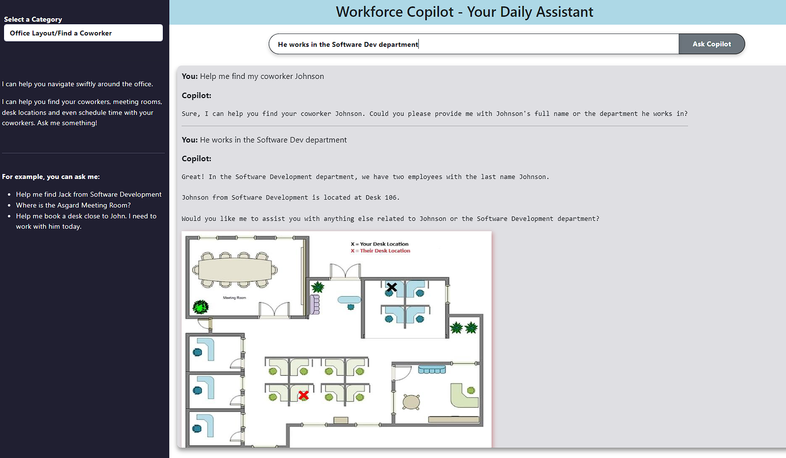




Introducing R.O.B – Employees’ Resourceful Office Buddy for everyday assistance
Employee
Has queries about the workplace
Helps find where people are located
Ask the Workplace Copilot Assistant
Assists in Performing Tasks & Provides Insights
Redirects to Tech/Customer Support If Requested
Video demonstration available in the Appendix Section

Slide 21
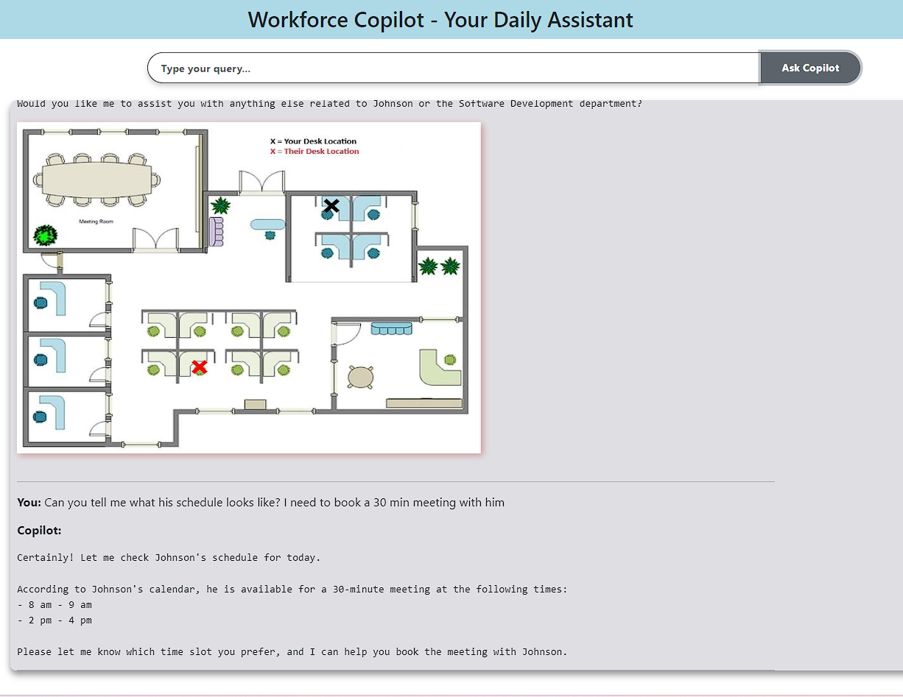
Introducing R.O.B – Employees’ Resourceful Office Buddy for everyday assistance
Employee
Has queries about the workplace
Ask the Workplace Copilot Assistant
Fosters easy collaboration with coworkers by being respectful of their schedules
Assists in Performing Tasks & Provides Insights
Redirects to Tech/Customer Support If Requested
Video demonstration available in the Appendix Section

Slide 22



Designated focus areas & re-imagined workspace design for enhancing productivity in concentration-heavy tasks
Noise Distractions – More than 2 Productive Hours Lost ^{[1]}
Concentration Demanding Tasks – ~22% better performance in quieter work areas ^{[2]}
Cubicles/Focus Rooms
Rationale
Initiatives
Noise Cancelling Headphones
Impact
Facilitate focused work at the office
Ensure collaboration does not disturb others
Strategic
Workplace Redesign
[1] Calculated as Per Week Per Employee
[2] Jahncke, H., & Hallman, D. M. (2020). Objective measures of cognitive performance in activity-based workplaces and traditional office types. Journal of Environmental Psychology, 72, 101503. https://doi.org/10.1016/j.jenvp.2020.101503

Slide 23



Merit Recognition & Development Opportunities to help drive a sense of purpose and ownership
Low Org. Engagement Satisfaction Score – WFH employees (3.5/5)
Low Cultural Quotient (leadership expectations, community building, purpose) – WFH employees (2.7/5)
Merit Spotlight Program
Rationale
Initiatives
Mentorship / Learning Initiatives
Impact
Recognition & Engagement – Can increase productivity by +7% ^{[3]} & reduce likelihood of quitting by 56% ^{[4]}
Drive “ownership culture” ^{[5]}
Periodic Employee Pulse Check
[1] Calculated on a scale of 0 (unsatisfied) to 5 (satisfied)
[2] Calculated on a scale of 0 (unimportant) to 5 (important)
[3] https://people.duke.edu/~dandan/webfiles/PapersPayoff/Scarcity_02June2015.pdf
[4] https://www.cnbc.com/2022/05/31/recognition-is-an-effective-way-to-keep-employees-from-quitting-.html [5] https://www.weinsteinspira.com/ownership-at-the-workplace-empowering-employees-to-drive-success/

Slide 24



Tailored recommendations can potentially save productive hours and boost employee satisfaction
~84%
33.48
1.5 Pts
Office Cohort (Time Lost – Layout)
Employees In This Group Facing Issue
Productive Hrs Increased
Potential Increase in Satisfaction
~78%
192.07
1.4 Pts
1.6 Pts
Overall Increase in Potential Satisfaction
Hybrid Force (Time Lost – Visitors)
Employees In This Group Facing Issue
Productive Hrs Increased
Potential Increase in Satisfaction
~76%
193
1.8 Pts
Home Anchors (Time Lost – Noise)
Employees In This Group Facing Issue
Productive Hrs Increased
Potential Increase in Satisfaction
~418 Hours
Overall Increase in Potential Productive Hrs Per Week
Assuming Implementation for a Medium Size Firm (500 Employee) | Assuming 60% Effectiveness of the proposed solutions | Satisfaction Scale: Very Unsatisfied (0) – (5) Very Satisfied

Slide 25
Estimated Immediate Impact vs Implementation Effort can be used to prioritize proposed solutions
Estimated Immediate Impact
Immediate Attention Noise Canceling Headphones Merit Spotlight Programs Mentorship/Learning Initiatives | Medium Term Initiatives Workforce Copilot Cubicles/Focus Rooms
Major Projects Strategic Workplace Design | Long Term Strategies Periodic Employee Pulse Check Feedback Implementation
Implementation Effort
Phase 1
Immediate Attention
Phase 2
Medium Term Initiatives
Phase 3
Major Projects
Phase 4
Long Term Strategies

Slide 26
Thank You! Questions?

Slide 27
APPENDIX

Slide 28





Objective: What are we trying to solve?
42% Feel More Productive at Home*
43% Feel More Productive at Office*
Recommendations and Deployment
Rule-Based Segmentation
Modeling for More Insights
Identifying Productivity and Preference Factors
Understand Employee’s Behavior
*Result of Forbes research through surveys. People are split about their preferences. https://www.forbes.com/sites/tracybrower/2023/08/06/the-productivity-problem-with-remote-work.

Slide 29


Preferred Workplace based on Culture Quotient
Socially active employees prefer office work
WFH employees tend to be more averse to social events
Highly Correlated
Leadership positively influences Org Culture
Opportunity to involve remote workers in cultural initiatives
Unite employees with a sense of belongings
*Average of DECSN factors H, K, L & Q; 0 = Unimportant, 5 = Important
Notes:
Forbes acknowledges the challenge of enforcing office culture in a WFH (Work From Home) setting

Slide 30
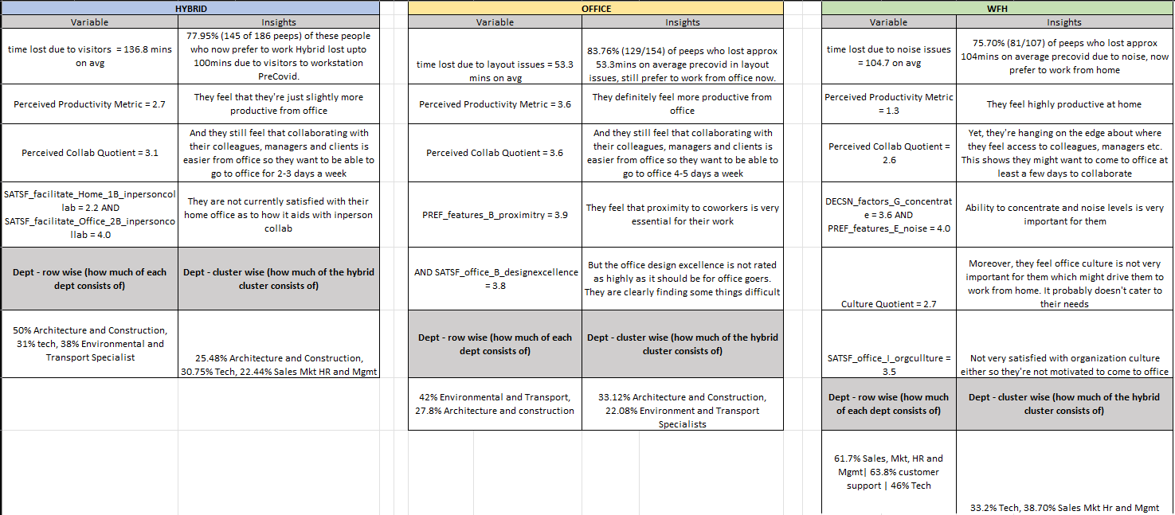
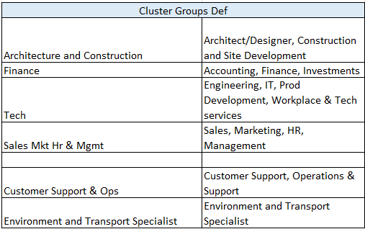
Cluster - Detailed

Slide 31
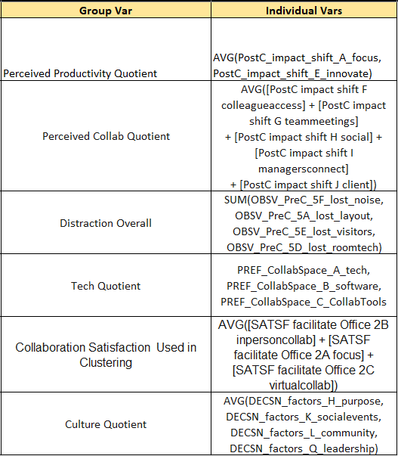
Important Variables

Slide 32
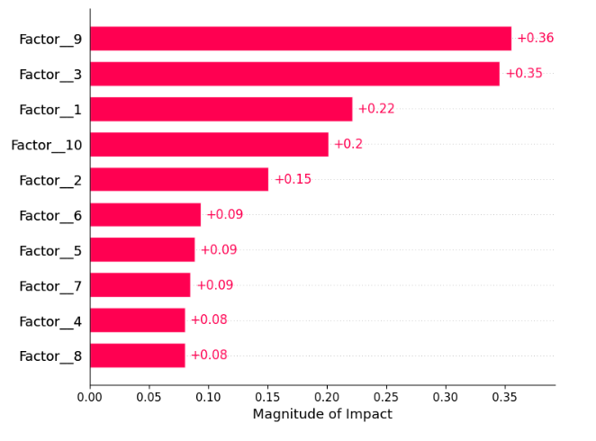
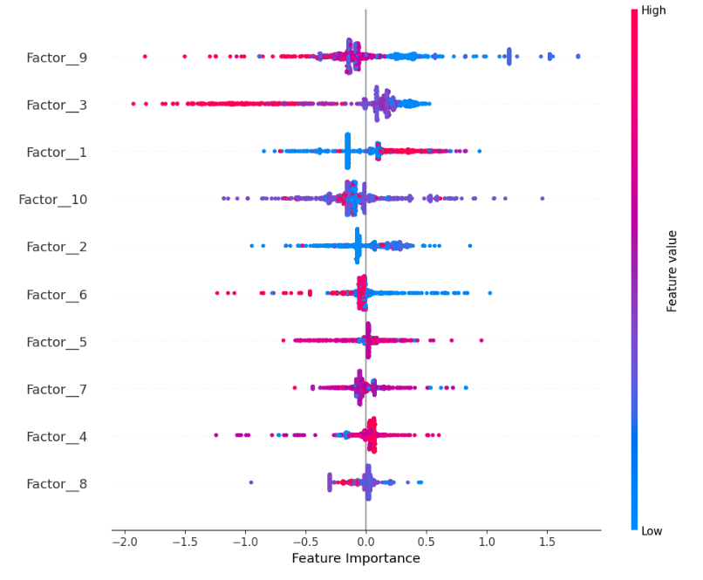
Shapley Analysis – Feature Importance (Target = Composite Work Location Preference Score)
Shapley Values for Each Factor
Direction of Impact

Slide 33
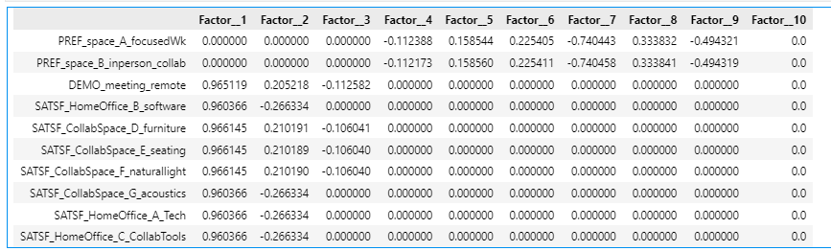
Factor Loadings – Factor 9 Major Contributors

Slide 34
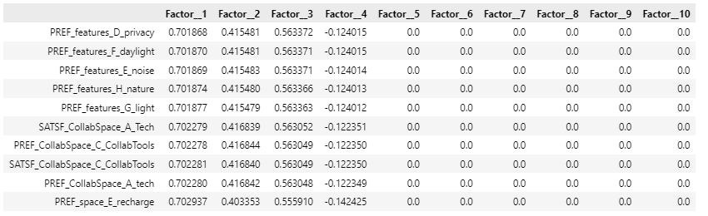
Factor Loadings – Factor 3 Major Contributors

Slide 35
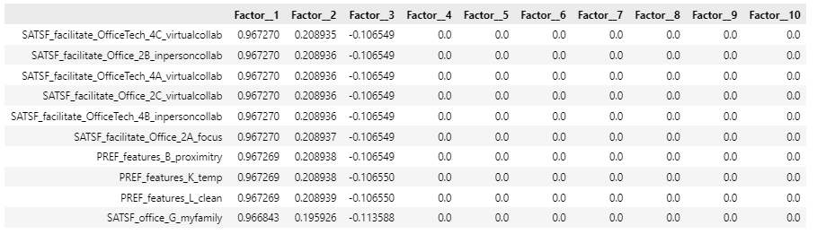
Factor Loadings – Factor 1 Major Contributors

Slide 36
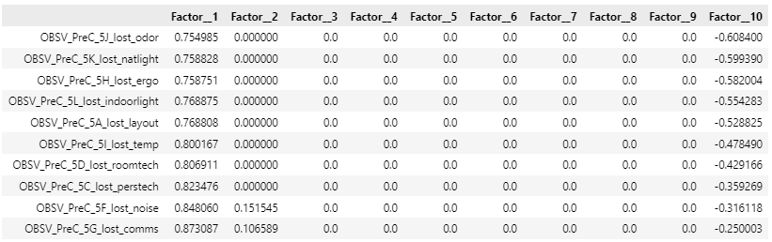
Factor Loadings – Factor 10 Major Contributors

Slide 37
Potential Increase in Productive Work Hours Calculations
 | Office = layout problems | Hybrid = unwanted visitor problems | WFH = noise problem
% Of People Out Of Entire Dataset [1] | 15% | 36% | 49%
% Of Employees who had issues in this cluster [2] | 83.76% | 78.00% | 75.70%
Assumed - Mid Size Organization with 500 employees [3] | 500 | 500 | 500
% of people in assumed organization that fall in this cluster [1]*[3] ---- [4] | 75 | 180 | 245
% of people with layout problem in assumed organization [2]*[4] --- [5] | 62.82 | 140.4 | 185.465
Mins lost Avg In a Week due to distraction [6] | 53.3 | 136.8 | 104
Mins lost total in assumed organization [5]*[6] --- [7] | 3348.306 | 19206.72 | 19288.36
Hours lost total per week [7]/60 --- [8] | 55.81 | 320.11 | 321.47
Assumed decrease in productive hours lost by implementing Workforce Copilot [9] | 0.6 | 0.6 | 0.6
Time Saved in Hrs Per Week [8]*[9] --- [10] | 33.48 | 192.07 | 192.88
Total Hours Saved In Organization SUM[10]-- [11] | 418.43 Hrs
 |  | Hybrid | Office | WFH
Group-1: Collaboration Satisfaction* > Avg(Collaboration Satisfaction) --- [1] | Avg. Collab_Satisfaction Rating --- 1.i | 4.3 | 4.3 | 4.3
 | Count of Collab_Satsf_Rule Rating --- 1.ii | 272 | 123 | 420
Group-2: Collaboration Satisfaction* < Avg(Collaboration Satisfaction) ---[2] | Avg. Collab_Satisfaction Rating -- 2.i | 2.9 | 2.8 | 2.5
 | Count of Collab_Satsf_Rule Rating --- 2.ii | 89 | 31 | 71
Employee Base Who have below avg satsf SUM(2.ii)/(Sum(2.ii) + Sum(1.ii))*100 --- [3] |  | 19%
Potential Bump In Satisfaction Points by Implementing Recommendations in this cluster [1.i] - [2.i] --- [4] |  | 1.4 | 1.5 | 1.8
Potential Bump In Satisfaction % by Implementing Recommendations [4]/[2.i] --- [5] |  | 48% | 54% | 72%
Potential Bump In Organization Satisfaction Points by Implementing Recommendations Overall Avg[4] --- [6] |  | 1.57
Potential Bump In Organization Satisfaction % by Implementing Recommendations Overall Avg[5]--- [7] |  | 57.95%
*Collaboration Satisfaction = ([SATSF facilitate Office 2B inpersoncollab] + [SATSF facilitate Office 2A focus] + [SATSF facilitate Office 2C virtualcollab])/3
Notes:
Forbes suggests WFH becoming the norm, focusing on minimizing distractions.
Techniques emphasized:
Controlling workflow.
Reducing multitasking.
Eliminating distractions.

Slide 38
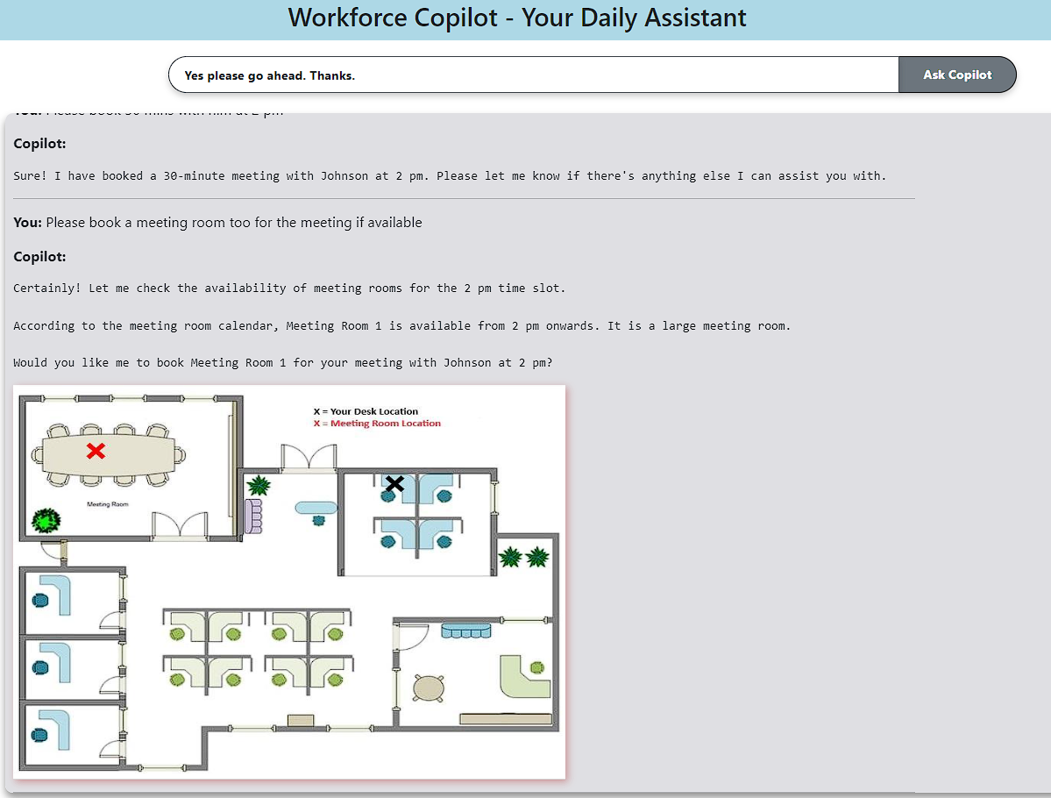
Introducing R.O.B – Employees’ Resourceful Office Buddy for everyday assistance
Employee
Has queries about the workplace
Ask the Workplace Copilot Assistant
Assists in Performing Tasks & Provides Insights
Provides office map of where meetings are setup to ensure easy navigation
Redirects to Tech/Customer Support If Requested
Video demonstration available in the Appendix Section

Slide 39
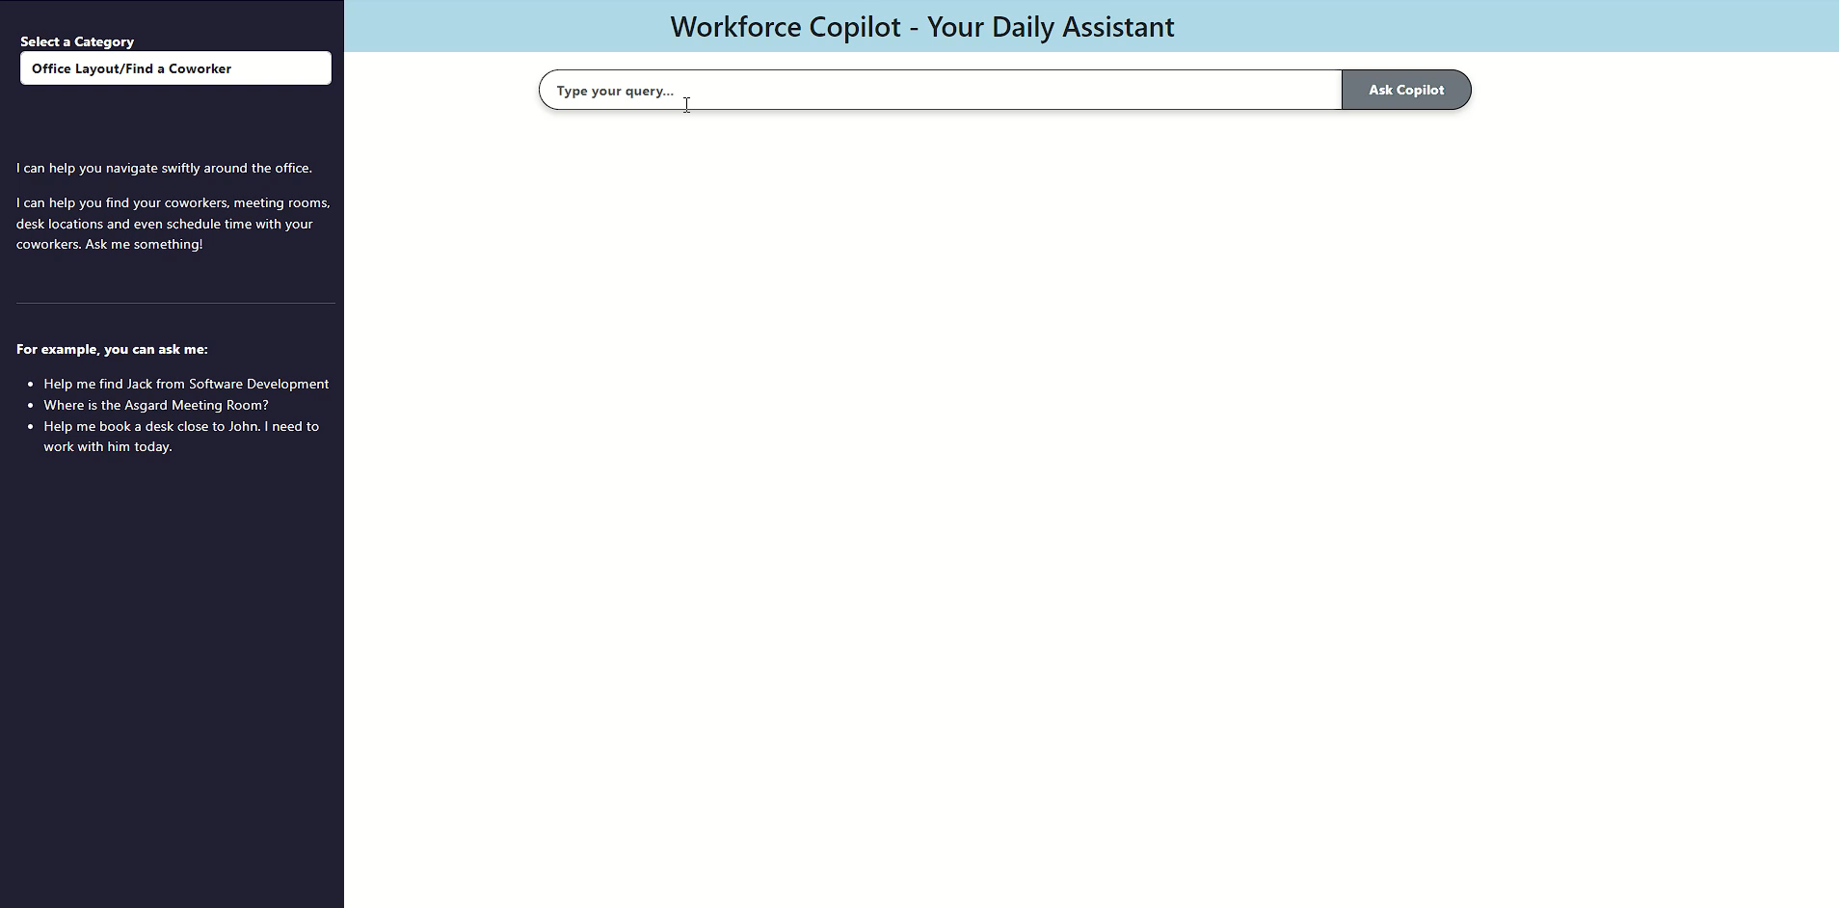
Copilot Demo – Video Walkthrough

Slide 40
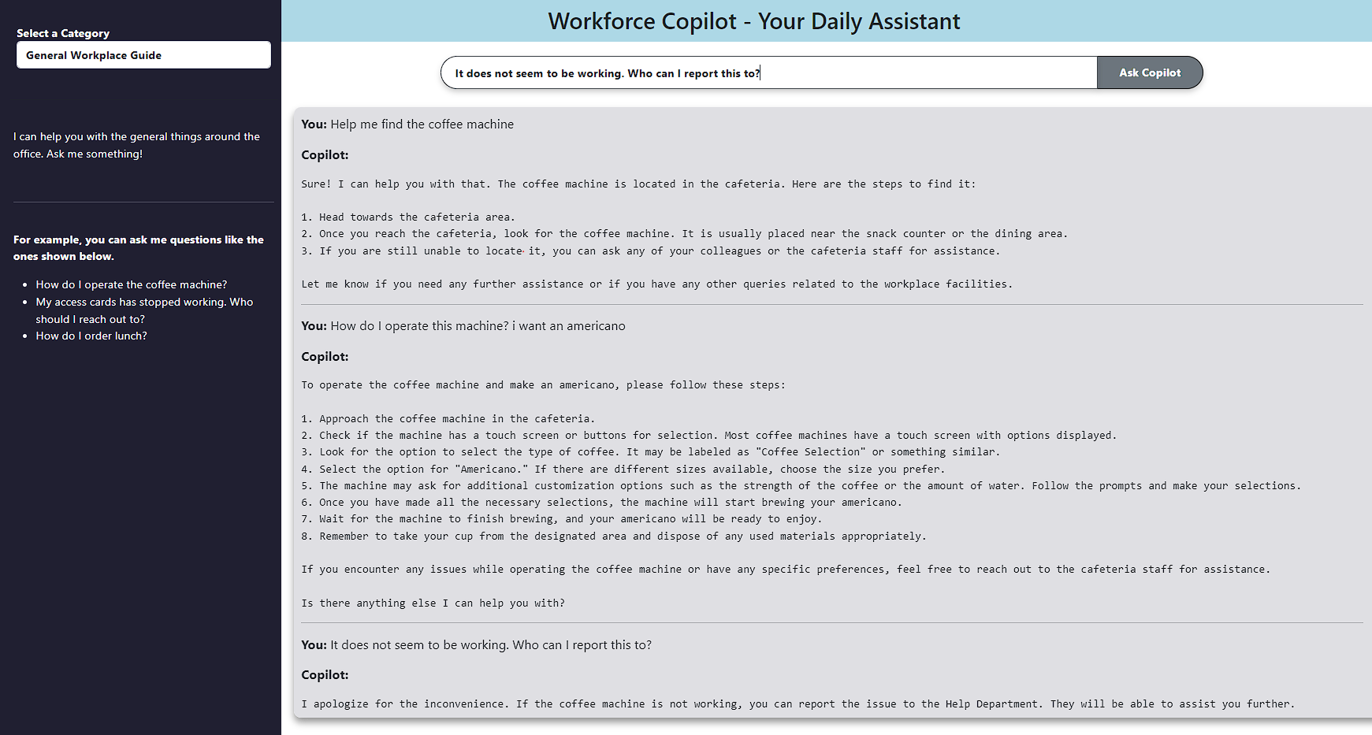
Copilot Demo – General Help Around The Office

Slide 41
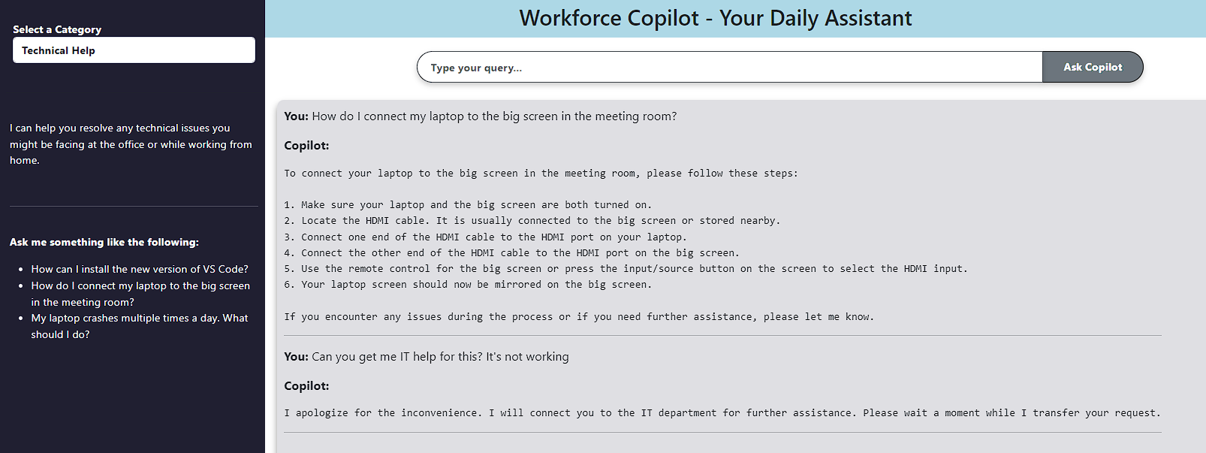
Copilot Demo – IT Support

Slide 42
Office Layout Issues +Visitor Disturb+ Ease Of Collaboration
Distraction Metrics | Employees with Sats < 3 (avg time lost) | Employees with Sats >= 3 | Percent difference
OBSV_PreC_5A_lost_layout | 53 min | 41 min | -24%
OBSV_PreC_5B_lost_looking | 81 min | 42 min | -49%
OBSV_PreC_5D_lost_roomtech | 33 min | 27 min | -18%
OBSV_PreC_5E_lost_visitors | 203 min | 109 min | -46%
Total | 307 min | 190 min | -38%

Slide 43
Noise And Focus
Moving from Dissatisfied to Satisfied
Expected Distraction Reduction
Distraction Metrics | Employees with Sats < 2.5 (avg time lost) | Employees with Sats >= 2.5 | Percent difference
OBSV_PreC_5F_lost_noise | 142 min | 49 min | -65%

Slide 44



Executive Summary
Employees have a wide range of preferences and very specific needs
Negative perception can drive down employee satisfaction
Need to understand employees and fine tune to support their work styles
Complication
Large no. of productive hours lost due to office layout and collaboration issues
Ability to collaborate effectively - key factor for determining work location
WFH Employees tend to be bit averse to cultural engagement – need to understand preferences & tailor engagement activities
Varying Problems
Introduce a Gen AI Workforce Copilot - empower employees with an assistant
Workplace design modifications to boost collaboration & focus
Fine-tune events to employee interests. Recognizing merit is key
Estimated 418 hours increase in productive hours per week.
Estimated Satisfaction Index improvement by almost 1.6 points
Recommendations

Slide 45

Ability to Collaborate Effectively is a key factor in determining Perceived Productivity
Perceived Collaborative Quotient
comprises abilities for:
Colleague Access
Manager Interaction
Client Engagement
High correlation between Perceived Productivity and Collaborative Quotients
[1] Average of Perceived Ability to Focus, Create, and Innovate; 0 = Home Preferred, 5 = Office Preferred
[2] Average of Perceived Ability for Colleague Access, Team Meetings Participation, Client Engagement, Social Events, and Manager Interaction; 0 = Home Preferred, 5 = Office Preferred

Slide 46
Improving collaborative capabilities at the office can be crucial
Improved Office Collab Setup
Office Collab Satisfaction ^{[1]}
Increased Satisfaction
(especially those with WFH Preference Rate of > 60%)
Enhanced Collaboration and Productivity
(While they are at office)
0-20%
20-40%
40-60%
60-80%
80-100%
WFH Preference Rate
[1] Average Satisfaction for Inperson and Virtual Collaboration using Office Space and Tech; 0 = Unsatisfied, 5 = Satisfied

Slide 47



Distractions may cause employees to stay at home to stay productive. Can lead to huge number of lost hours
(Pre-Covid) More Time Lost Due to Distractions
Layout Issues
280
274
Noise Disturbances
Time Loss Due to Distractions
(Minute/Week)
256
Visitor Disruption
210
189
Distractions (Pre-Covid) cause employees to stay home to be productive
Office goer might opt for home office option in the future to reduce distraction
WFH Preference Rate
0-20%
20-40%
40-60%
60-80%
80-100%
Productivity Quotient ^{[1]} | 3.6 | 3.2 | 1.9 | 1.8 | 0.6
More productive at home
[1] Average of Perceived Ability to Focus, Create, and Innovate; 0 = Home Preferred, 5 = Office Preferred

Slide 48
Preferred Workplace based on Culture Quotient
Socially active employees prefer office work
WFH employees tend to be more averse to social events
[1] Average Importance of Factors (Sense of Purpose, Belonging, and Community; Social Events; Community Initiatives; Leaderships Expectation/Policy Guidance) Influencing Decision to WFH or at Office; 0 = Unimportant, 5 = Important
Notes:
Forbes acknowledges the challenge of enforcing office culture in a WFH (Work From Home) setting

Slide 49


Ability to spend uninterrupted focused hours drives work location preferences
Employees who love to do focused work at home
0.8
WFH Preference Rate
0.6
Employees who love to switch from focused work to collaborative work/social events intermittently
0.4
0.2
Employees who love to do focused work at office with privacy
0.0
Home
Temporary Workspace
Office Workstation
Enclosed Office Space
Preferred Environment
for Focus Work

Slide 50
The desire for uninterrupted, focused hours shapes preferences for work locations
Preferred Environment for Focused Work
0.8
Employees who like to switch from focused work to collaborative work/social events intermittently prefer open workspaces
WFH Preference Rate
0.6
0.4
0.2
0.0
Home
Temporary Workspace
Office Workstation
Enclosed Office Space

Slide 51

“Composite Work Location Preference” score highly correlated to WFH Preference Rate
-2.4
Ability to
Be Individually Productive
Ability to
Collab Effectively
Composite Work Location
Preference Score ^{[1]}
Strongly
Influence
0-20%
20-40%
40-60%
60-80%
80-100%
Location Employee Want to Work in
WFH Preference Rate
[1] Average of Perceived Optimal Work Environment for Supporting All Aspects ; 0 = Home Preferred, 5 = Office Preferred.
Used as a Proxy to handle missing values in WFH Pref Rate Metric

Slide 52
Modeling

Slide 53


Factor Analysis & Shapley Values corroborate our analysis about the key factors for determining work location preference
Key Factors – Derived from Shapley Analysis of Predictive Modeling Outcomes
Preprocess Data For Modeling
Factor Name | Factor Alignment / Description | Shapley Values
Factor 9 – Workspace for Focus & Collab | Preferred workspace and location for in-person collaboration and tasks that require undivided attention | 0.36
Factor 3 – Workplace Features Preference | Importance of workplace and work environment features | 0.35
Factor 1 - Collaboration Satisfaction | Employee satisfaction levels with respect to collaboration in the workplace | 0.22
Factor 10 – Productivity Hindrances | Major workplace issues that contributed to loss of productive hours | 0.20
Decompose
with Factor
Analysis
Data to information
Decision Tree Model
Shapley Analysis
+
Analyze Factor
Loadings
Note: “Compositive Work Location Preference Score” is used as Target Variable for Decision Tree Model Calculated as an Average of Perceived Optimal Work Environment for Supporting All Aspects ; 0 = Home Preferred, 5 = Office Preferred.

Slide 54
Factor Analysis & Shapley Values corroborate our analysis about the key factors for determining work location preference
Factor Name | Factor Alignment / Description | Shapley Values
Factor 9 – Workplace for Focus & Collab | Preferred workplace and location for in-person collaboration and tasks that require undivided attention | 0.36
Factor 3 – Workplace Features Preference | Importance of workplace and work environment features | 0.35
Factor 1 - Collaboration Satisfaction | Employee satisfaction levels with respect to collaboration in the workplace | 0.22
Factor 10 – Productivity Hindrances | Major workplace issues that contributed to loss of productive hours | 0.20
Preprocess Data For Modeling
Decompose
with Factor
Analysis
Decision Tree Model
Shapley Analysis
+
Analyze Factor
Loadings
Note: “Compositive Work Location Preference Score” is used as Target Variable for Decision Tree Model Calculated as an Average of Perceived Optimal Work Environment for Supporting All Aspects ; 0 = Home Preferred, 5 = Office Preferred.

Slide 55
Segmenting Employees can help us understand their specific needs
Productivity and Preference of Work Location
Home Anchors
64% Customer Support
62% Sales, Mktg, HR, Mgmt
46% Tech
Hybrid Force
50% Construction & Architecture
38% Environmental & Transport
Office Cohort
42% Environmental & Transport
27% Architecture & Construction
EDA + INSIGHTS + MODEL LED TO 3 SEGMENTS

Slide 56
Segmentation – Cluster 1 (WFH Employees)
Productivity and Preference of Work Location
Home Anchors
64% Customer Support
62% Sales, Mktg, HR, Mgmt
46% Tech
Hybrid Force
50% Construction & Architecture
38% Environmental & Transport
Office Cohort
42% Environmental & Transport
27% Architecture & Construction
105 min/week
4.0^{[a]}
2.6^{[b]}
2.6^{[a]}
Noise Distraction
Low Noise Focus
Ability to focus (3.6)
Noise level (4.0)
Collab
Hanging on the edge about where to access others
Culture
Not satisfied nor interested in organizational culture
^{[a]} - On a scale 0 – 5 (5 being the most important), ^{[b]} - On a scale 0 – 5 (0 – better at home, 5 – better at office)

Slide 57
Segmentation – Cluster 2 (Hybrid Employees)
Productivity and Preference of Work Location
Home Anchors
39% Sales, Mktg, HR, Mgmt
33% Tech
Hybrid Force
25% Architecture & Construction
31% Tech
22% Sales, Mktg, HR, Mgmt
Office Cohort
33% Architecture & Construction
22% Environment & Transport
137 min/week
PROBLEM
PREFERENCE
SATISFACTION
2.7^{[b]}
3.1^{[b]}
Visitor Disruption
Productivity
Feel slightly more productive at office
Collab
They need some collab accessibility at office
In-person Collab
Home (2.2)
Office (4.0)
2.2^{[c]}
^{[b]} - On a scale 0 – 5 (0 – better at home, 5 – better at office), ^{[c]} - On a scale 0 – 5 (5 being the most satisfied)

Slide 58

Segmentation – Cluster 3 (Work from Office Employees)
Productivity and Preference of Work Location
Home Anchors
39% Sales, Mktg, HR, Mgmt
33% Tech
Hybrid Force
25% Architecture & Construction
31% Tech
22% Sales, Mktg, HR, Mgmt
Office Cohort
33% Architecture & Construction
22% Environment & Transport
53 min/week
3.9^{[a]}
3.6^{[b]}
3.8^{[c]}
Layout Distraction
Proximity
Proximity to coworkers is very important to them
Collab
Feel that it’s easy to access others at office
Office Design
There’s still room of improvement on office design
^{[a]} - On a scale 0 – 5 (5 being the most important), ^{[b]} - On a scale 0 – 5 (0 – better at home, 5 – better at office), ^{[c]} - On a scale 0 – 5 (5 being the most satisfied)

Slide 59

Recommended Actions – Targeted action can resolve the key issues for each group
Personal Office Assistant
Facilitates Easy Navigation In Office
Fosters Channelized Collaboration
WORKFORCE COPILOT

Slide 60


Recommended Actions – Targeted action can resolve the key issues for each group
Personal Office Assistant
Facilitates Easy Navigation In Office
Fosters Channelized Collaboration
O
Noise Canceling Headphones
Cubicles/Focus Rooms
Strategic Workplace Design
Merit Spotlight Program
Learning Club Initiatives
Periodic Employee Pulse
WORKFORCE COPILOT
FOCUS DRIVERS
CULTURE CODE ENHANCEMENT

Slide 61
Recommended Actions – Targeted action can resolve the key issues for each group
O
Noise Canceling Headphones
Cubicles/Focus Rooms
Strategic Workplace Design
Employees perform 17-22% better with cognitive tasks in quieter work-zones/rooms^{[1]}
Adding a visual enclosure is significantly more beneficial for tasks requiring perseverance.^{[2]}
Office design should provide an environment in which employees are able to cope with challenges^{[3]}
FOCUS DRIVERS

Slide 62
Recommended Actions – Targeted action can resolve the key issues for each group
Merit Spotlight Program
Learning Club Initiatives
Periodic Employee Pulse
Individual employee performance recognition increases productivity by 7.3% and team recognition increases productivity by 5.2%.^{[1]}
Employees are 56% less likely to quit if they are recognized for their effort. Employees are also 73% less likely to feel burned out when their efforts are recognized.^{[2]}
Fostering a strong “ownership culture” promotes employee motivation, performance and loyalty.^{[3]}
Research shows L&D programs built directly into the flow of work upskills employees therefore providing the maximum ROI.^{[3]}
CULTURE CODE ENHANCEMENT

